Slide 1



DeDoDe v2: Analyzing and Improving the DeDoDe Keypoint Detector
Johan Edstedt
CVL, Linköping University
Georg Bökman
Chalmers University of Technology
Zhenjun Zhao
Chinese University of Hong Kong
Texas A&M University

Slide 2
Background: 30 Second Intro to DeDoDe v1
DeDoDe v1 is a keypoint detector
It’s partially trained to detect SIFT detections that survive SfM
I.e. 2D detections that are connected to a 3D track
This is called the “detection prior”
It’s also trained to maximize self-consistency
Done by cross-entropy between single-view logits, and top-k 2-view logits
It’s regularized to spread the detections uniformly over MVS depth

Slide 3
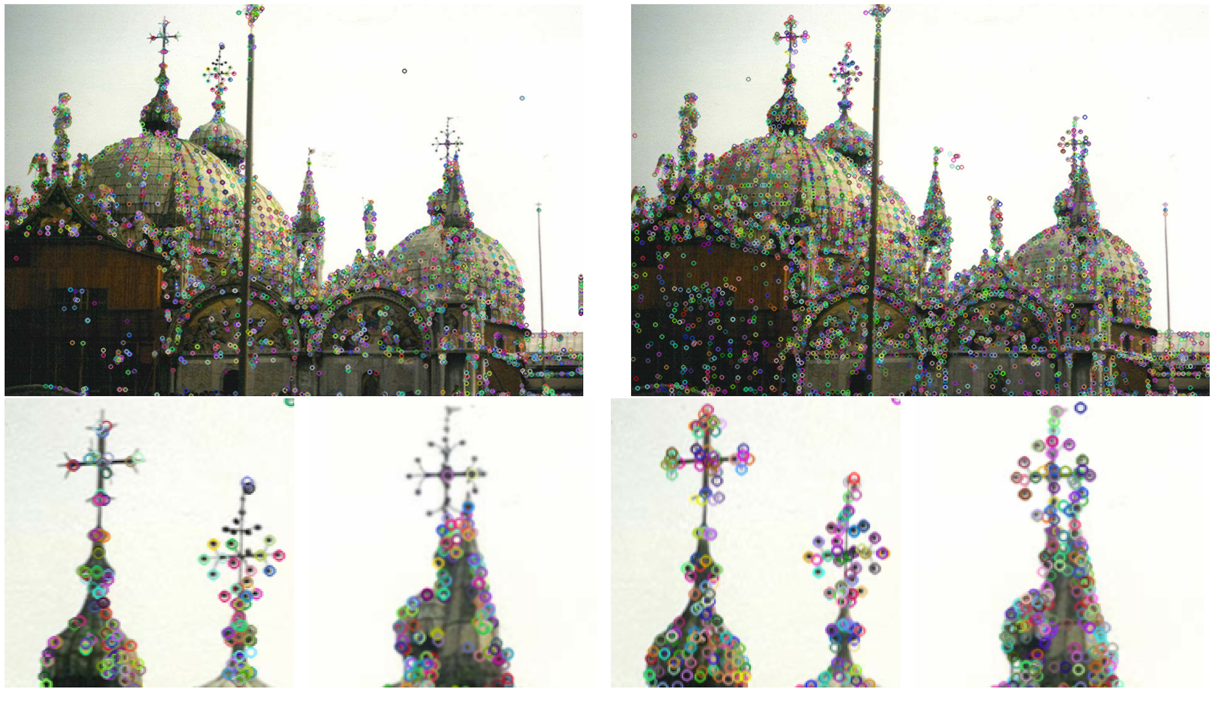
The Good News
v1 🡪 v2

Slide 4
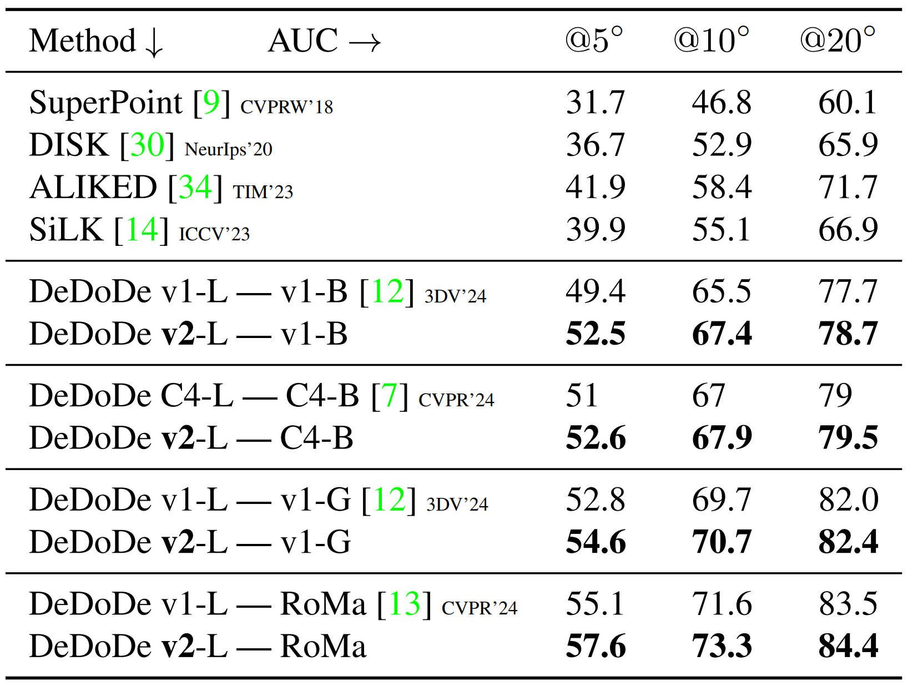
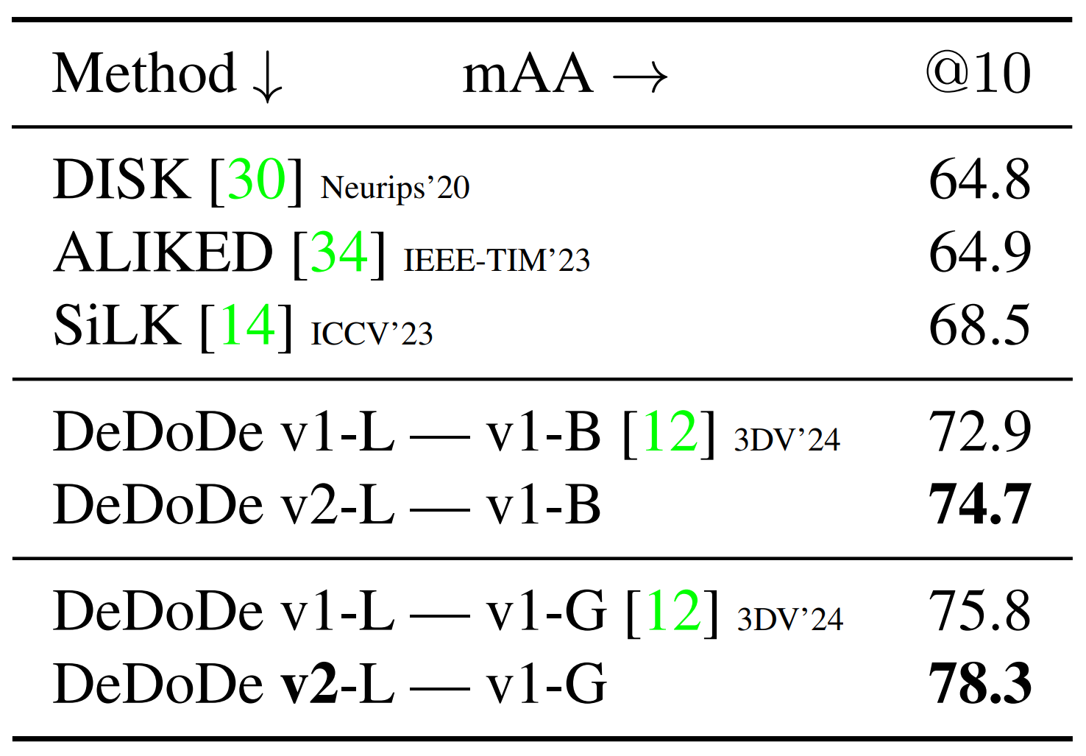
The Good News
We made some improvements to DeDoDe:
Quantitively:
Mega1500
IMC22

Slide 5
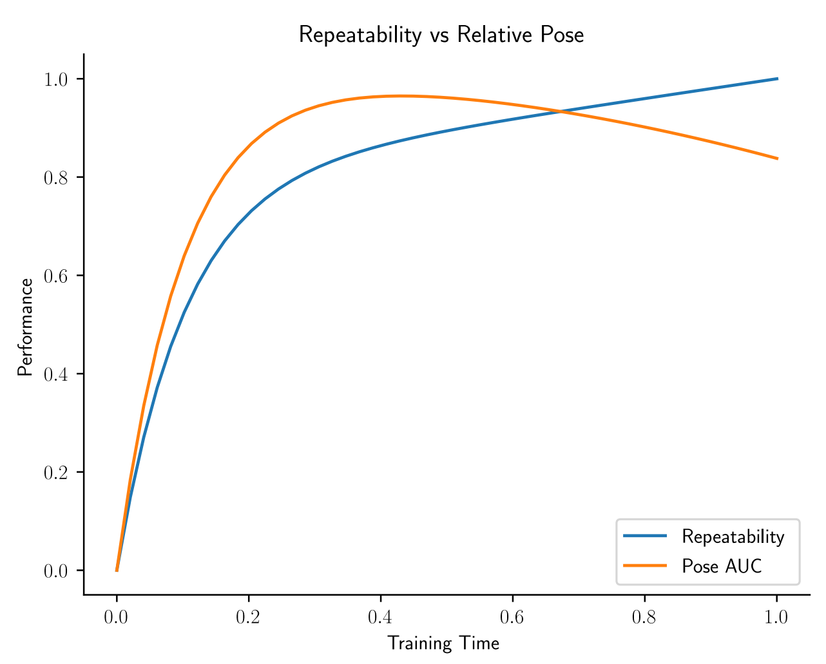
What’s Different?
Significantly shorter training time
Prevents overfitting to objective

Slide 6
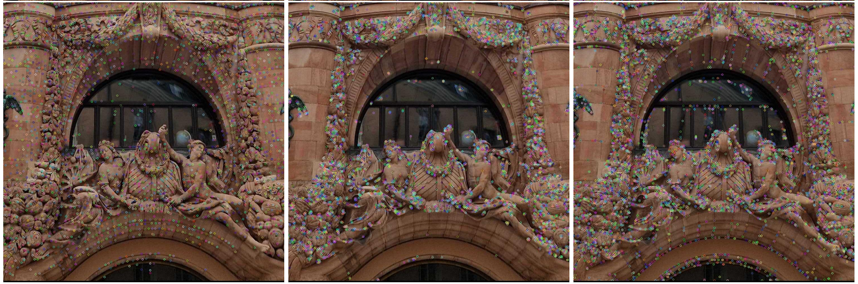
DISK VS DeDoDe v1 VS DeDoDe v2
DISK not repeatable, but well distributed
DDD v1 repeatable, not well distributed
DDD v2 repeatable, ~well distributed

Slide 7
What’s Different?
Traintime NMS
NMS on targets during training
Not during inference (still degrades performance)
Similar things of course exist in previous work
See e.g. peakiness loss in R2D2

Slide 8
What’s Different?
Minor improvements:
Big Rotation Aug
Already in Steerers
Helps with SO2 invariance
Top-k per image instead of per-batch during training
Actually this is what is described in v1, but code doesn’t do it…
Prevents net from ignoring difficult images

Slide 9
What didn’t help?
A bunch of things we tried with no effect:
Post-hoc diversity
I.e. trying to modify logits to give better spread
Modifying the “detection prior”
e.g. the weight (incl. annealing it over training), the standard dev,
Modifying the k in top-k
Changing the regularizer
E.g. to completely uniform, or removing it, or changing the loss weight
Learning rate
10^-4 confirmed best learning rate
Resolution
Investigated lower,higher
Also investigated if aspect ratio matters
Spoiler: It doesn’t
NMS during inference
Still doesn’t help us
Might not be good in general for “SIFT”y detectors

Slide 10
The Bad News & Some Hope
Probably repeatability is not such a good metric
Needs to be pose, with a good RANSAC
Some work in this direction already exists please try it for detectors!

Slide 11
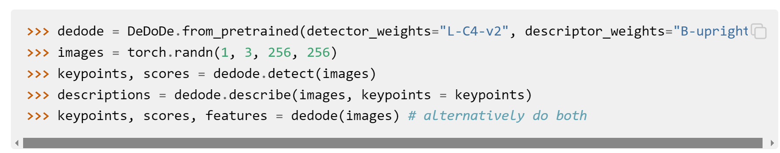
Final Slide
Weights are in github.com/parskatt/dedode,
or you can use kornia
Also heard it was useful for one of the imc24 teams, happy to hear it ☺
If you want to get in touch, dm me @ twitter.com/Parskatt
Or open an issue and complain about my code, or other stuff I messed up

Slide 12
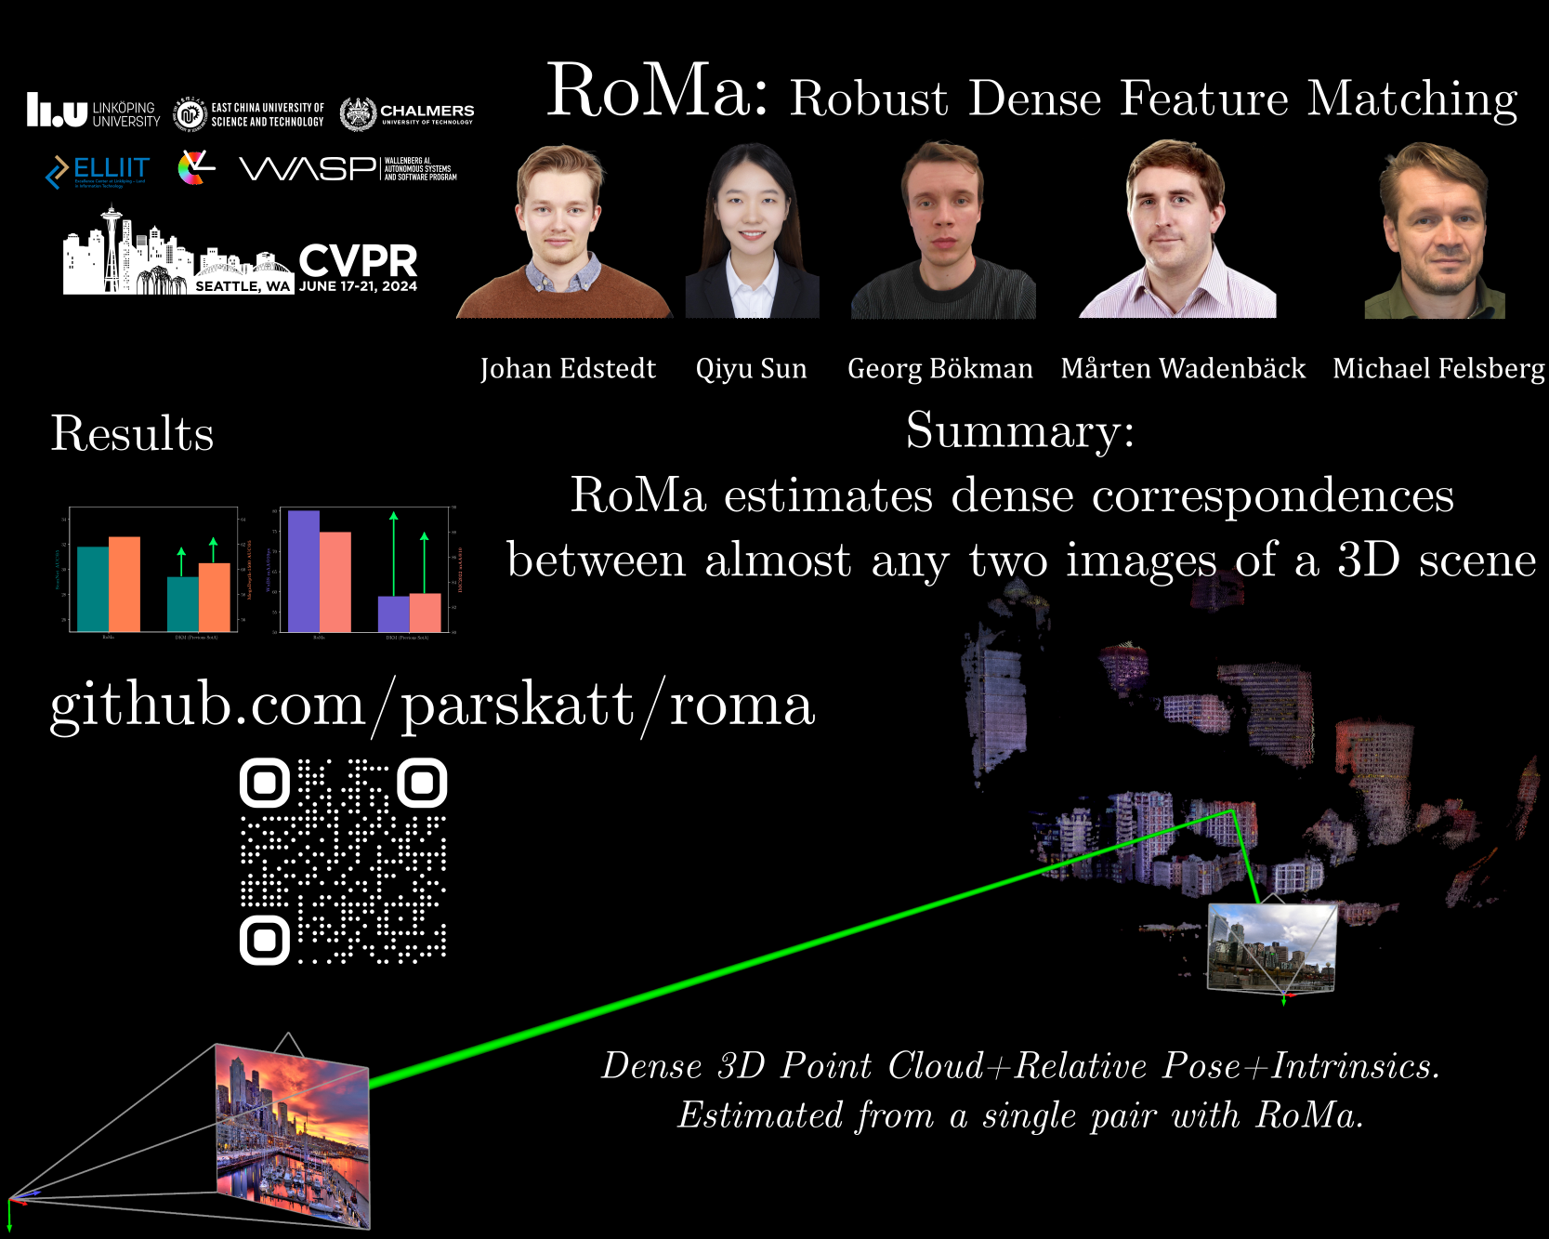
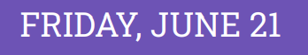
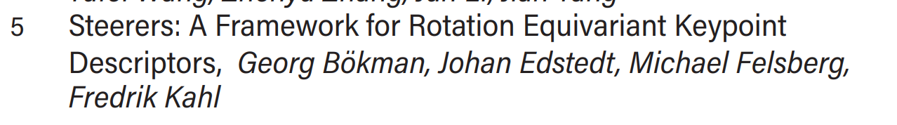

Final Slide (copy)
Check out the poster for RoMa!
And the Oral+Poster for Steerers!

Slide 13
Final Slide (copy 2)
A keypoint detector detects.

Slide 14
Final Slide (copy 2)
A keypoint detector detects. The points that it detects are called detections.

Slide 15
Final Slide (copy 2)
A keypoint detector detects. The points that it detects are called detections.
A keypoint descriptor describes.

Slide 16
Final Slide (copy 2)
A keypoint detector detects. The points that it detects are called detections.
A keypoint descriptor describes. The points that it describes are called descriptions.

Slide 17
Final Slide (copy 2)
A keypoint detector detects. The points that it detects are called detections.
A keypoint descriptor describes. The points that it describes are called descriptions.
Note that people sometimes misspell these as “descriptors”.

Slide 18
Final Slide (copy 3) (final)
Will be working on matching again this autumn, looking for group
Let me know if you’re interested in collaborating

